Slide 1
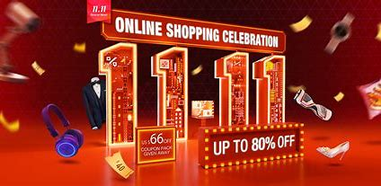
Double 11
What to buy~~?
Is your shopping trolley full?

Slide 2
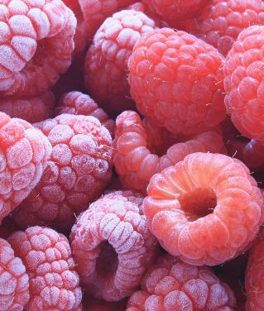
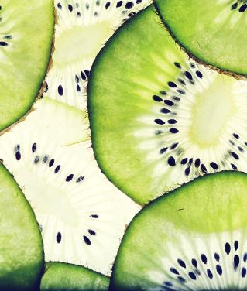
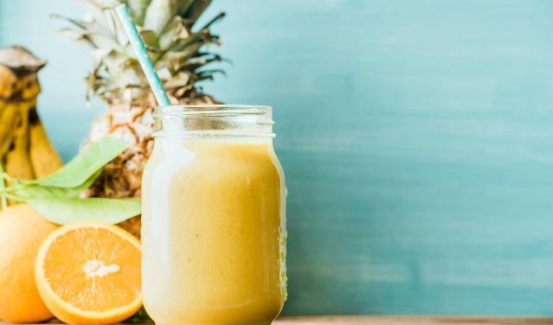
Things to buy Ways to use Problems to consider

Slide 3
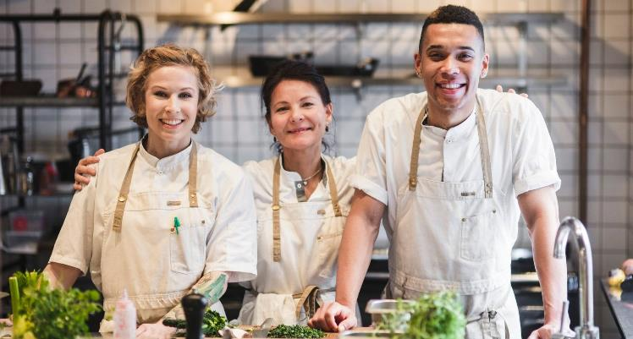
What’s your most unforgettable shopping experience?

Slide 4

How much/ what do you buy in this double 11? Who do you by these things for?

Slide 5
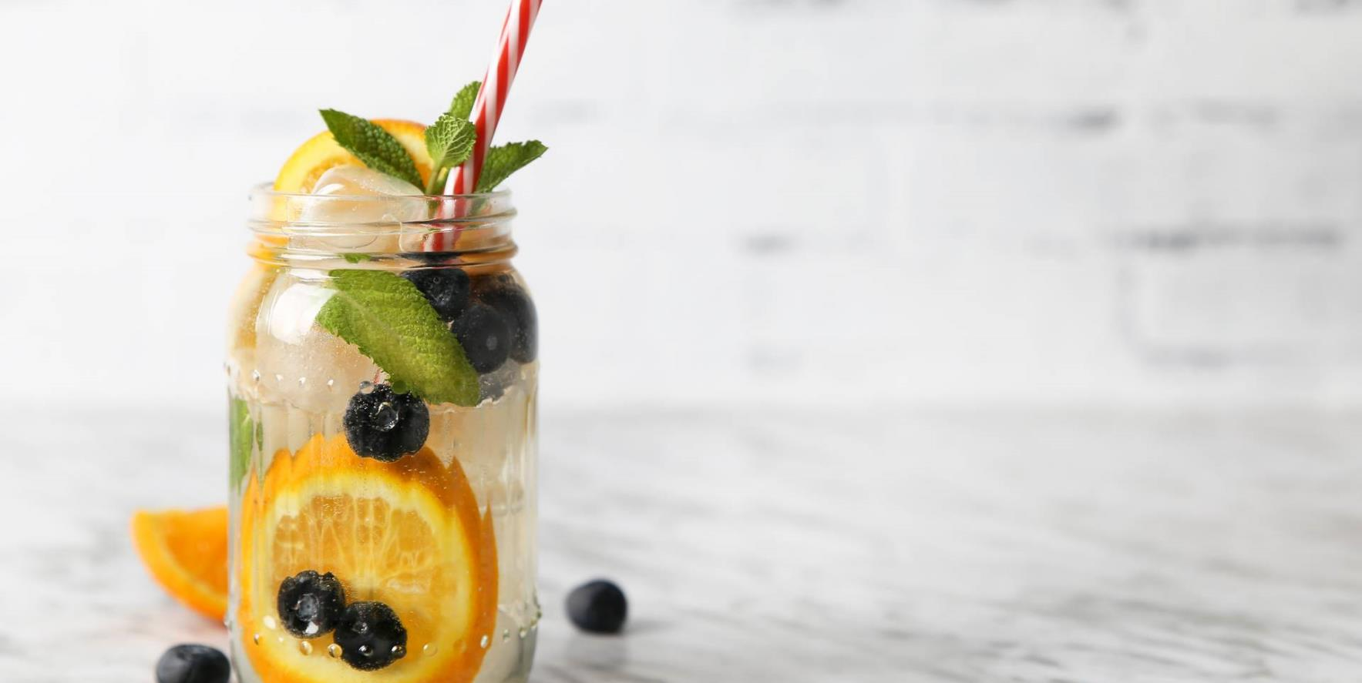
Please list 3 things you recommend most to buy.

Slide 6
Which online platform do you like most and why? Taobao, Jingdong or something else?

Slide 7
Which one do you prefer, online shopping or offline shopping?

Slide 8
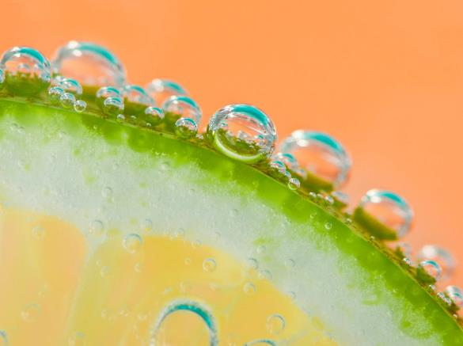
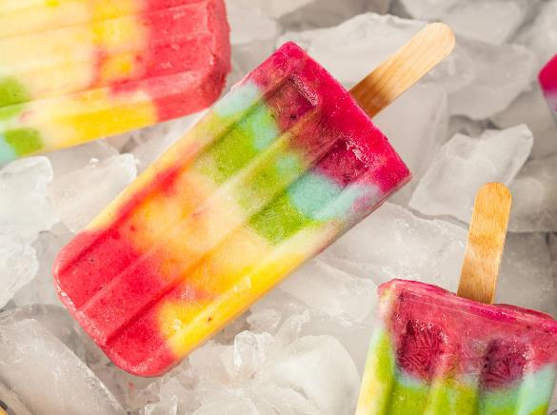

What do you think about the recommendation algorithms on shopping apps ? Useful or useless?

Slide 9
Please talk about the impact of online shopping to physical stores.

Slide 10
Is there any changes in double 11 since Covid-19? Economy/ Society…

Slide 11
Are you a minimalist or consumerist person? Will you buy luxury goods that beyond normal life requirements?

Slide 12
Your expectation to further shopping mode. Image what it would be like in 5 years.

Slide 13
Thanks for participation~ yujiao

